Slide 1
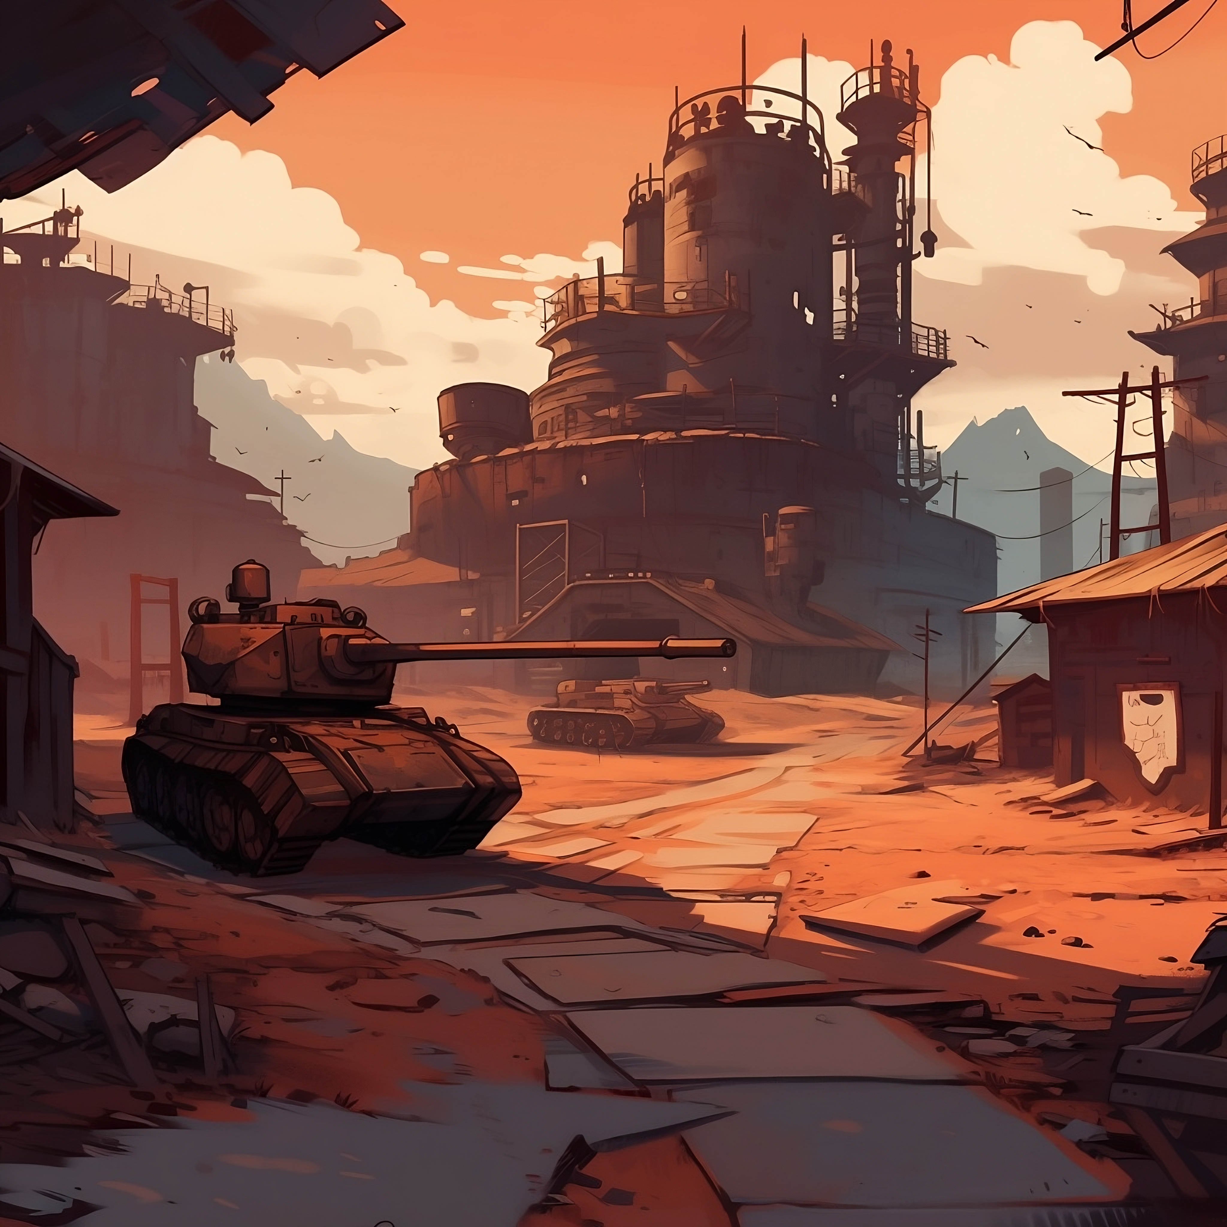

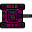




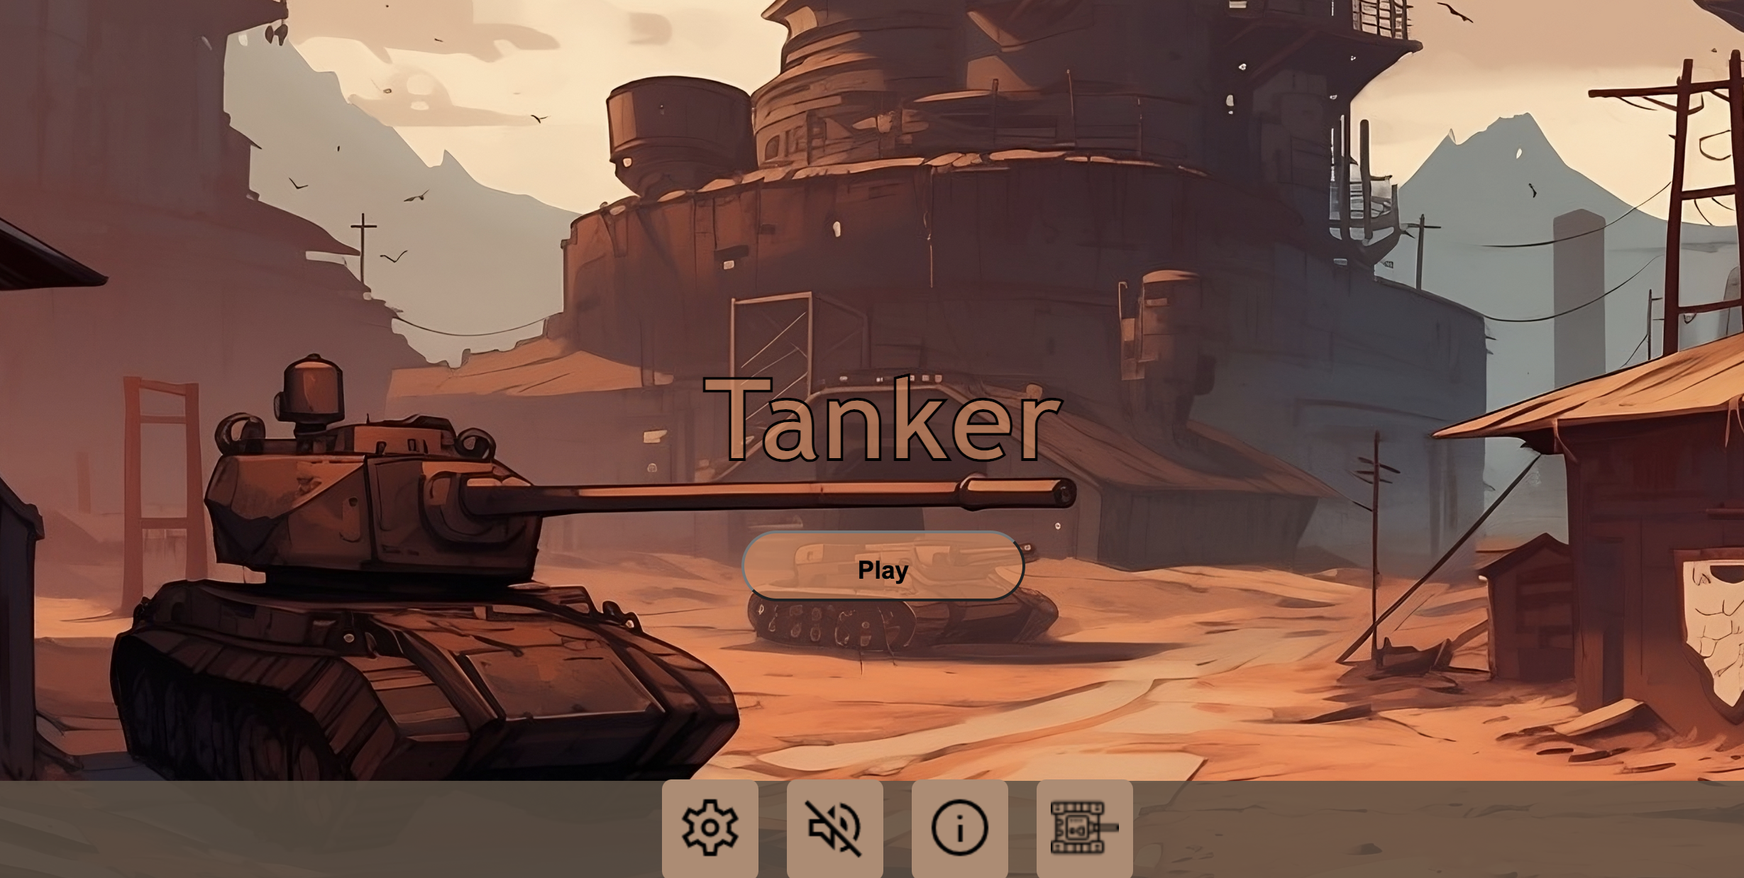
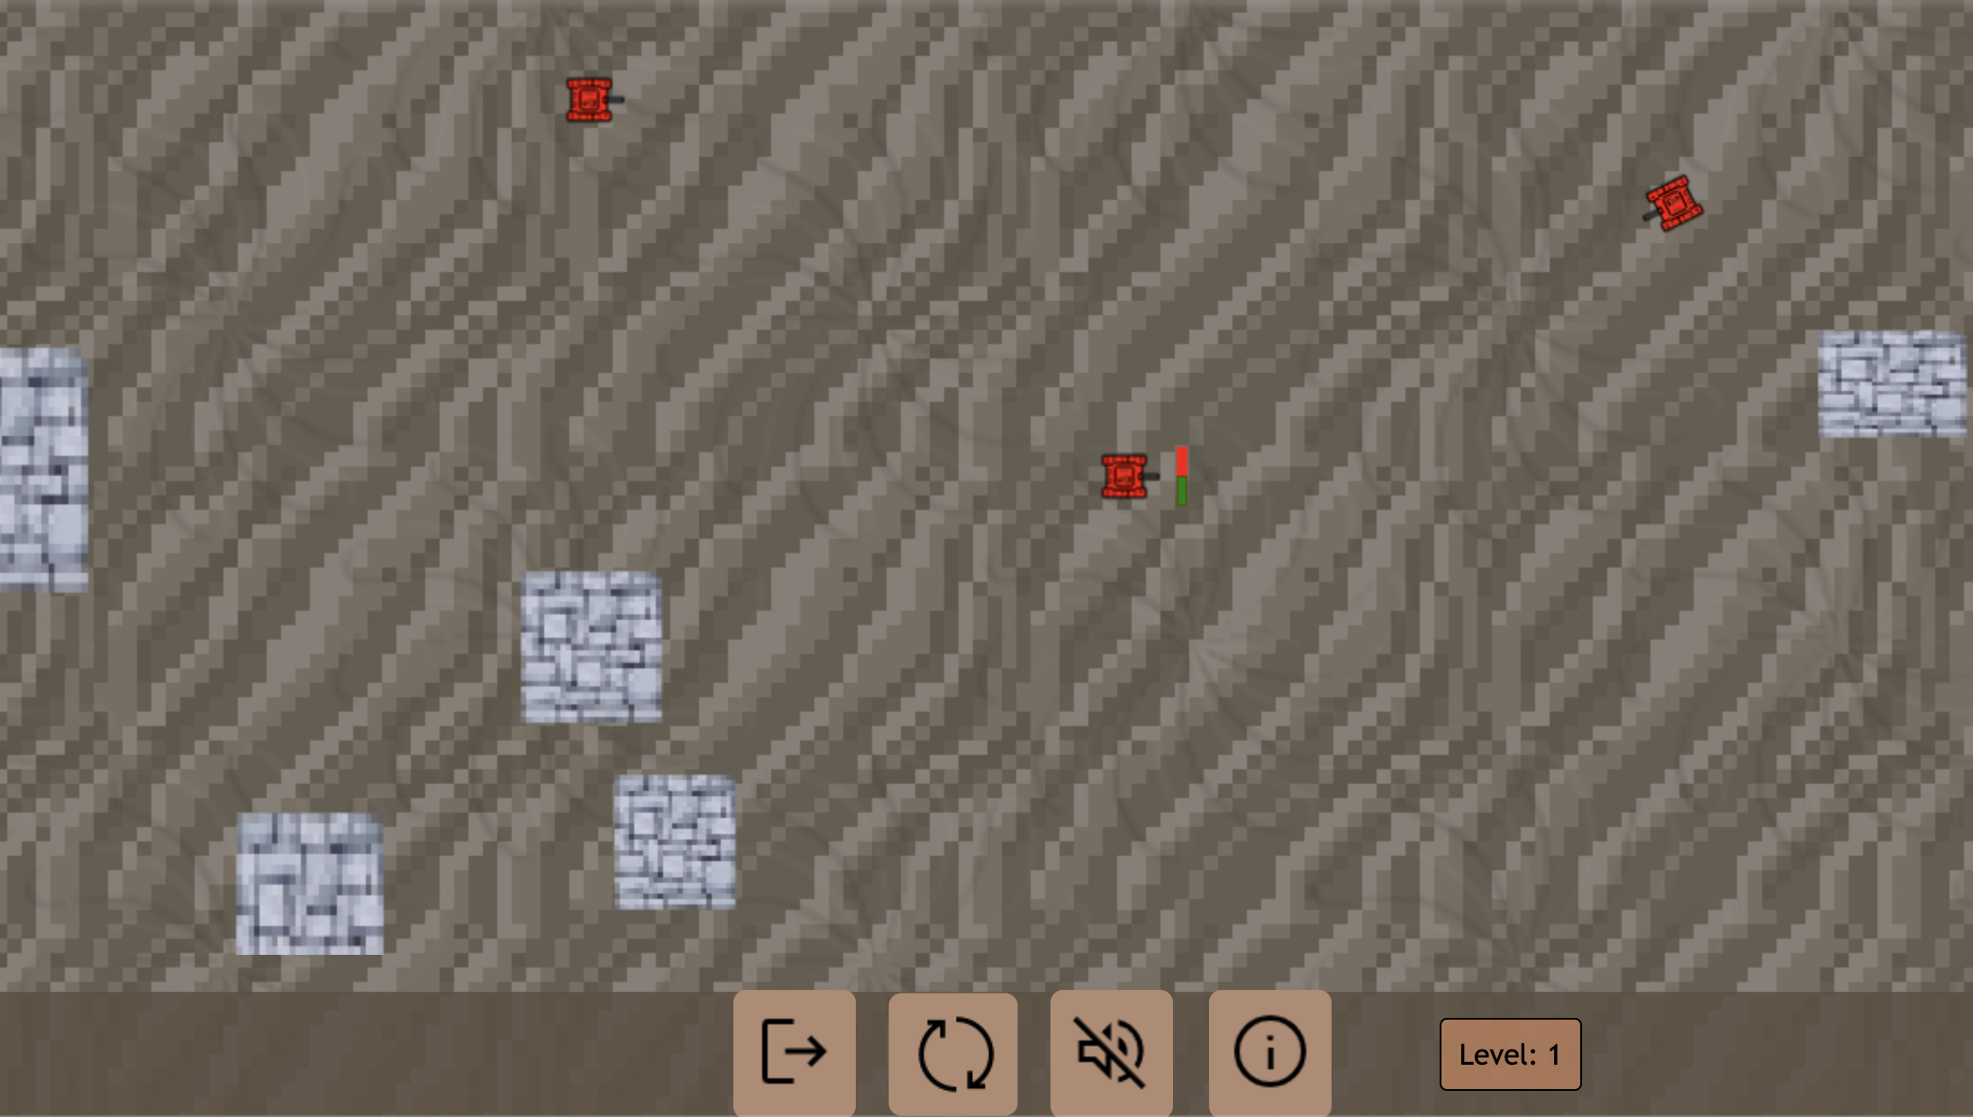
TANK GAME FHDW
Created by Oliwer Krzyszczyk & Jan Simons
UNIQUE MAP LAYOUT EVERY ROUND
CHOOSE YOUR OWN TANK COLOR
DIFFERENT DIFFICULTIES
EMPOWERED ON LEVEL SUCCESS
AI-ENHANCED ENEMIES
INTUITIVE HANDLING

